Slide 1


VARIANCE ANALYSIS

Slide 2

Module Agenda
Introduction to Variance Analysis
Variance Analysis Key components
Variance Analysis Example and Applications
Variance Analysis Steps
Practical Project 1: GenAI for Sales and Volume Variance Analysis
Practical Project 2: Store variance analysis using GenAI
Practice opportunities
© All rights reserved for Dr. Ryan Ahmed @Stemplicity Inc.

Slide 3
Financial Planning and Analysis
Data Wrangling & Analysis: Automate reconciliation and analysis of financial data.
Competitor Analysis: Analyze competitors' financials and strategic positioning.
Anomaly Detection: Identify errors in financial transactions with AI.
Time Series Forecasting: Predict financial performance using historical data and market trends.
Variance Analysis: Analyze actuals vs. budgets to pinpoint variances and corrective actions.
Scenario Planning: Model scenarios to evaluate business decisions' financial impacts.
Financial Narratives: Generate AI-driven insights for clear stakeholder communication.
Cost Optimization: Identify inefficiencies and recommend cost-saving measures.
Data Visualization: Visualize financial data for strategic decision making
Financial Prediction Using ML Regression: Predict financial metrics such as revenues& expenses.
Financial Planning and Analysis (FP&A) is a critical business function that focuses on providing financial insights to support decision-making and drive a company’s strategic objectives.
It involves analyzing financial data, forecasting future financial performance, budgeting, and offering recommendations to enhance financial health and operational efficiency.
© All rights reserved for Dr. Ryan Ahmed @Stemplicity Inc.

Slide 4
INTRODUCTION TO VARIANCE ANALYSIS

Slide 5

Introduction to Variance Analysis
Variance Analysis is a financial and operational analysis technique used to compare actual performance with planned or expected performance.
It helps organizations understand the reasons behind deviations from a budget or forecast.
© All rights reserved for Dr. Ryan Ahmed @Stemplicity Inc.

Slide 6
Variance Analysis Key Components
Budget or Standard: The expected or planned value (e.g., budgeted expenses, sales forecasts, or standard costs).
Actual Performance: The real, observed values during a period.
Variance: The difference between the actual and expected values.
Favorable Variance (F): When actual performance is better than expected (e.g., lower costs or higher revenues).
Unfavorable Variance (U): When actual performance is worse than expected (e.g., higher costs or lower revenues).
© All rights reserved for Dr. Ryan Ahmed @Stemplicity Inc.

Slide 7
Practical Example
Imagine a department store budgeted $1 million for marketing in Q4, expecting a 10% sales increase. However, actual marketing expenses were $1.2 million, and sales only increased by 8%. Variance analysis would:
Calculate the variances:
Marketing Expense Variance: ($1.2M - $1M) = $200K (Unfavorable).
Sales Volume Variance: (8% - 10%) = -2% (Unfavorable).
Investigate the reasons for discrepancies:
Why were marketing costs higher than expected?
Why did sales not meet the projected target?
Recommend actions:
Re-evaluate marketing strategies.
Optimize campaigns to increase ROI.
© All rights reserved for Dr. Ryan Ahmed @Stemplicity Inc.

Slide 8
Variance Analysis Steps
Identify Variances:
Calculate differences for each category (e.g., cost, revenue).
Classify Variances:
Label them as favorable (F) or unfavorable (U).
Investigate Causes:
Determine why the variance occurred (e.g., market conditions, inefficiencies).
Take Action: Develop strategies to address unfavorable variances or replicate conditions that led to favorable ones.
© All rights reserved for Dr. Ryan Ahmed @Stemplicity Inc.

Slide 9
Variance Analysis Applications
Industries:
Retail: Understanding sales trends and optimizing inventory.
Manufacturing: Identifying production inefficiencies and controlling costs.
Financial Services: Analyzing budget deviations and enhancing financial planning.
Examples:
Retail: A clothing store uses variance analysis to track sales variances by season and adjust marketing strategies accordingly.
Manufacturing: A car manufacturer monitors material cost variances to negotiate better supplier contracts.
Financial Services: A bank analyzes operational cost variances to reduce expenses and improve profitability.
© All rights reserved for Dr. Ryan Ahmed @Stemplicity Inc.

Slide 10
PRACTICAL PROJECT 1: GENAI FOR SALES AND VOLUME VARIANCE ANALYSIS

Slide 11
Problem Statement
Scenario: You are a financial analyst at Walmart Mega Store, tasked with conducting a variance analysis using generative AI assistance.
Your goal is to leverage Generative AI to:
Calculate precise variance metrics
Interpret the financial implications
Develop strategic recommendations
Product Category | Budgeted Sales | Actual Sales | Budgeted Volume | Actual Volume
Power Tools | $500,000 | $550,000 | 2,000 | 2,200
Outdoor Equipment | $350,000 | $325,000 | 1,500 | 1,400
Painting Supplies | $250,000 | $250,000 | 1,000 | 1,000
Lumber | $600,000 | $580,000 | 3,000 | 2,900
© All rights reserved for Dr. Ryan Ahmed @Stemplicity Inc.

Slide 12
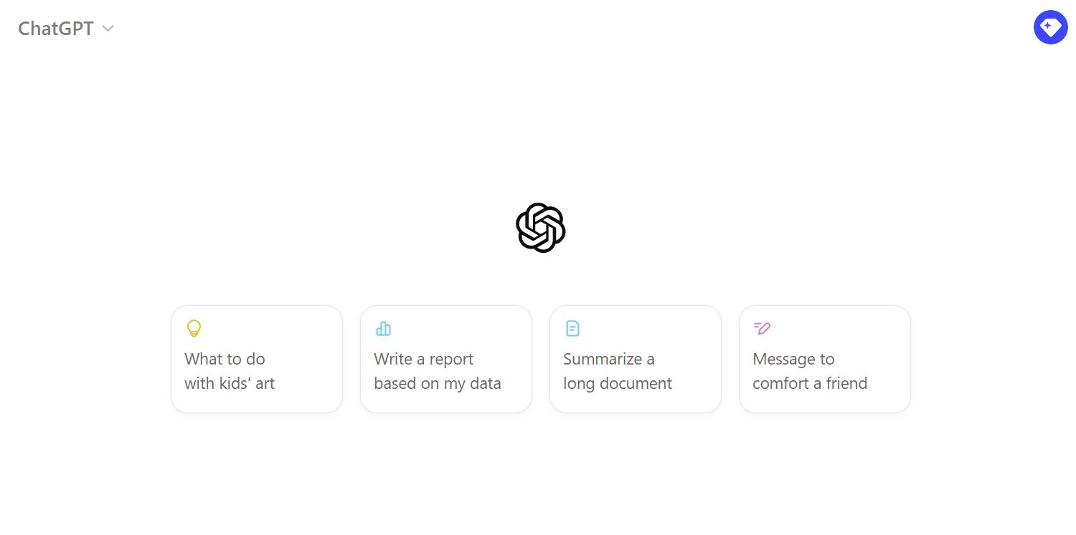
Practical Project
🔗 Click here to explore ChatGPT ChatGPT Signup
💡 Click here for AI Prompts Explore Prompts
© All rights reserved for Dr. Ryan Ahmed @Stemplicity Inc.

Slide 13
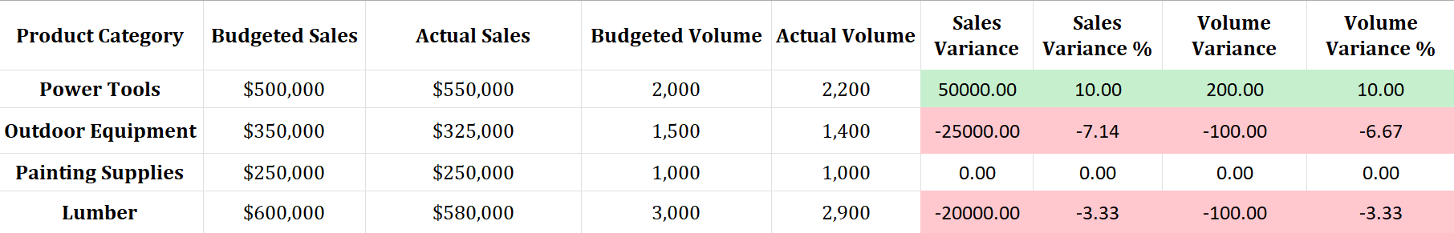
User Prompt 1: Variance Calculations Expected Output
© All rights reserved for Dr. Ryan Ahmed @Stemplicity Inc.

Slide 14
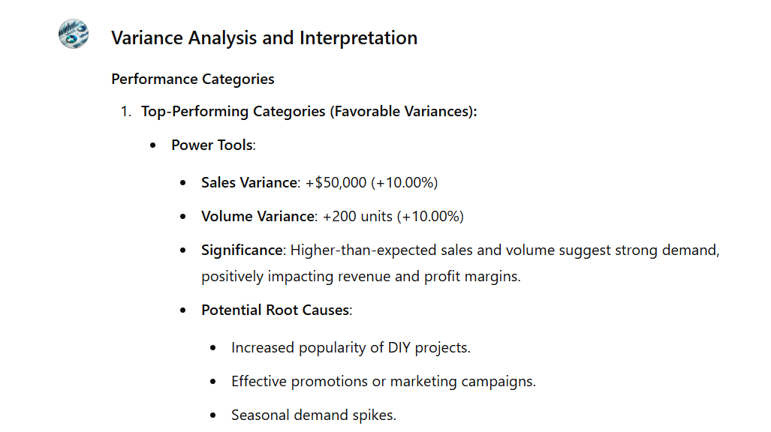
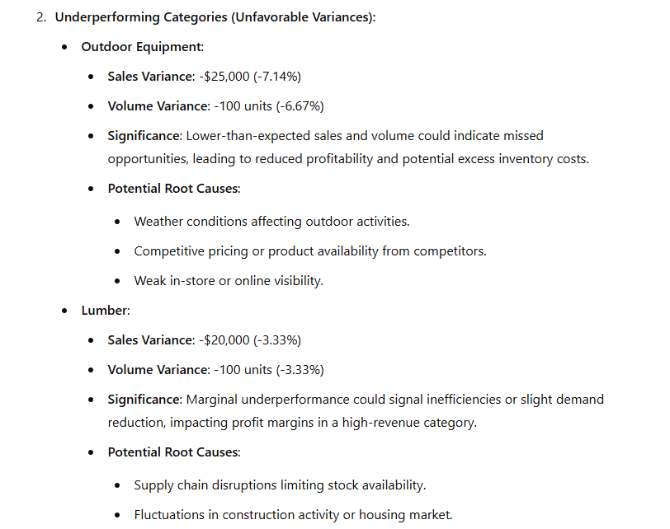
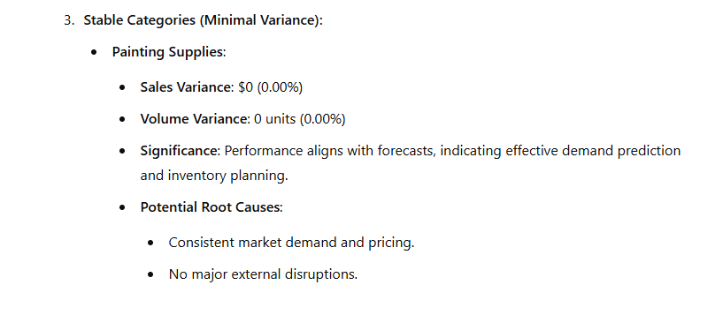
User Prompt 2: Variance Analysis Interpretation – Part 1
© All rights reserved for Dr. Ryan Ahmed @Stemplicity Inc.

Slide 15
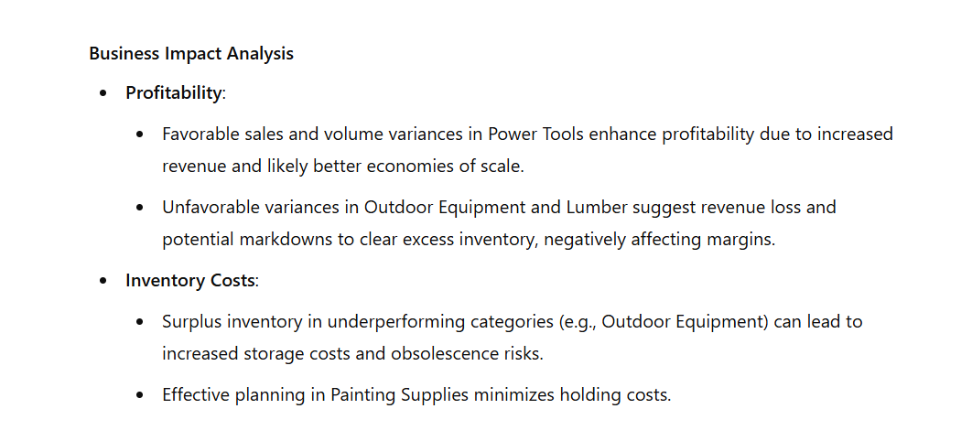
User Prompt 2: Variance Analysis Interpretation – Part 2
© All rights reserved for Dr. Ryan Ahmed @Stemplicity Inc.

Slide 16
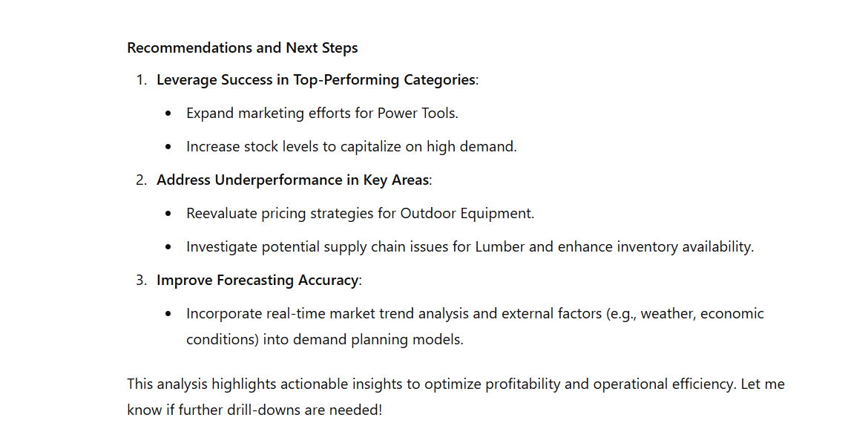
User Prompt 2: Variance Analysis Interpretation – Part 3
© All rights reserved for Dr. Ryan Ahmed @Stemplicity Inc.

Slide 17
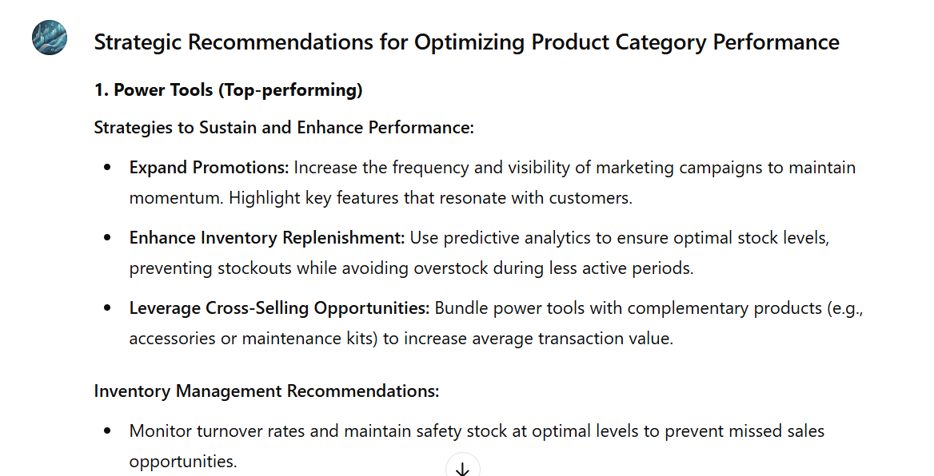
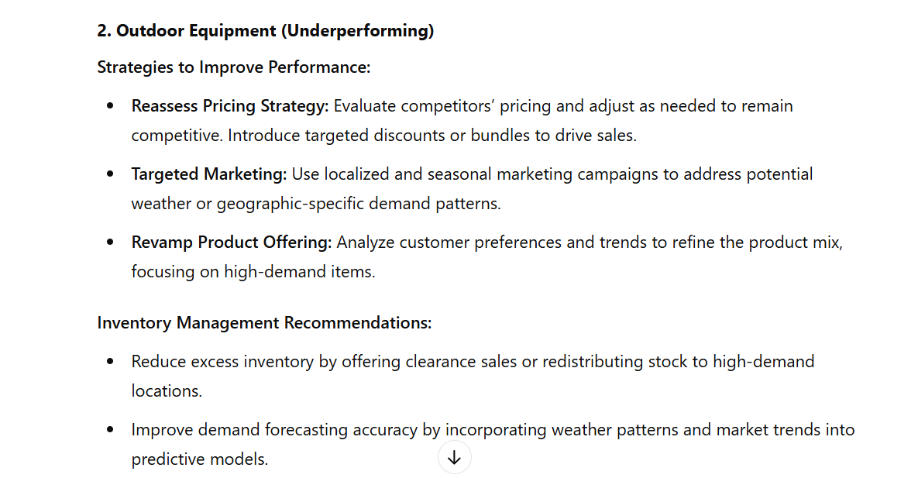
User Prompt 3: Develop Strategic Recommendations – Part 1
© All rights reserved for Dr. Ryan Ahmed @Stemplicity Inc.

Slide 18
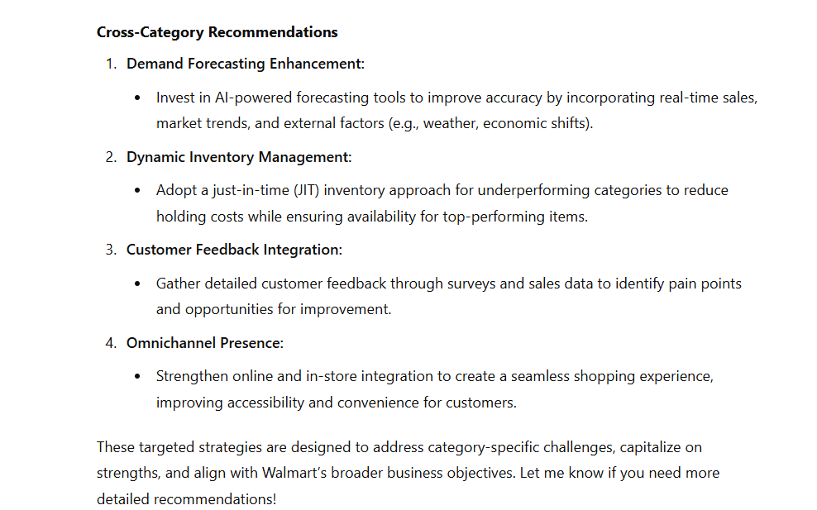
User Prompt 3: Develop Strategic Recommendations – Part 2
© All rights reserved for Dr. Ryan Ahmed @Stemplicity Inc.

Slide 19
PRACTICE OPPORTUNITY

Slide 20

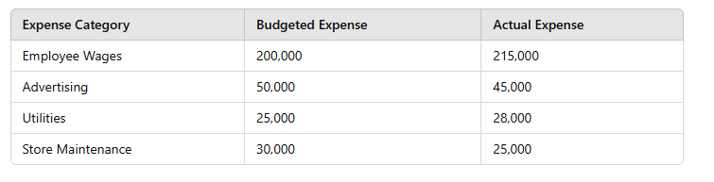
Practice Opportunity
HomeSense, a leading home décor and furniture retailer, shares actual vs. budgeted expense data for its major operational categories.
The goal is to analyze the variances, identify performance trends, and develop actionable recommendations to optimize cost efficiency and financial management.
© All rights reserved for Dr. Ryan Ahmed @Stemplicity Inc.

Slide 21
Practice Opportunity
Task 1: Perform Variance Calculations
Calculate:
Expense Variance = Budgeted Expense - Actual Expense
Expense Variance % = (Variance / Budgeted Expense) × 100
Highlight:
Favorable variances (below budget) in green.
Unfavorable variances (above budget) in red.
Task 2: Interpret Variances
Categorize performance:
Cost-Efficient Categories (favorable).
Cost-Overrun Categories (unfavorable).
On-Budget Categories (minimal variance).
Explain:
Significance of variances (profitability, cash flow, efficiency) and potential root causes (e.g., overtime, repairs, market trends).
Task 3: Develop Strategic Recommendations
© All rights reserved for Dr. Ryan Ahmed @Stemplicity Inc.

Slide 22
Practice Opportunity Solutions
🔗 Click here to explore ChatGPT ChatGPT Signup
💡 Click here for AI Prompts Explore Prompts
💡 Click here for Practice Opportunities Solution Explore Prompts
© All rights reserved for Dr. Ryan Ahmed @Stemplicity Inc.

Slide 23
PRACTICAL PROJECT 2: STORE VARIANCE ANALYSIS USING GENAI

Slide 24
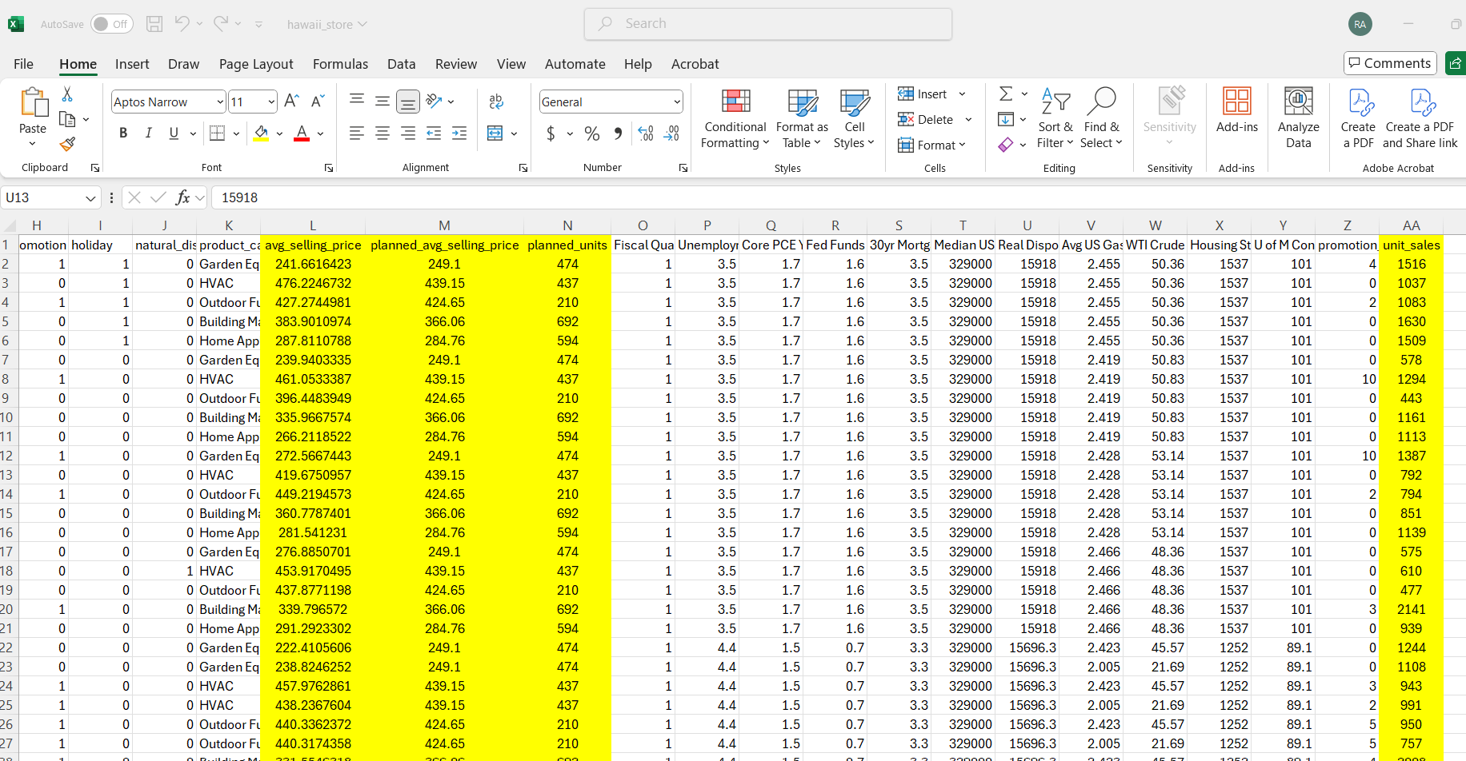
Problem Statement
You are provided with data for a Department Store for 4 stores: Hawaii, Miami, Texas, and Virginia.
© All rights reserved for Dr. Ryan Ahmed @Stemplicity Inc.

Slide 25
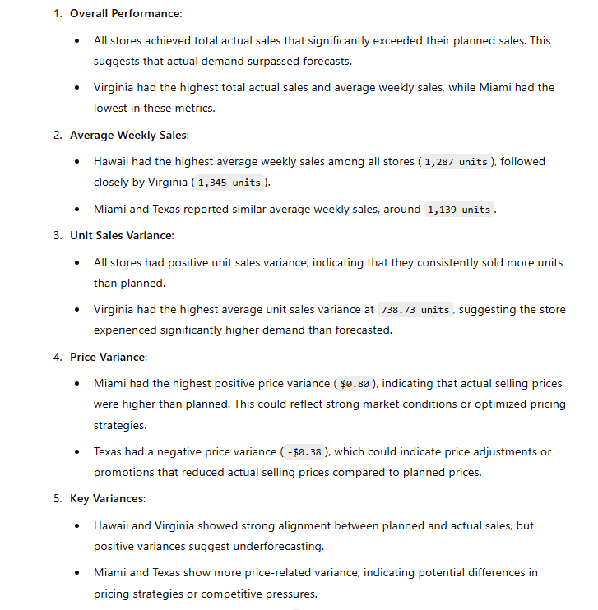
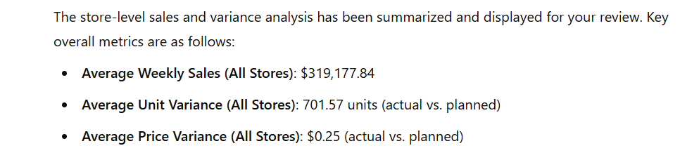
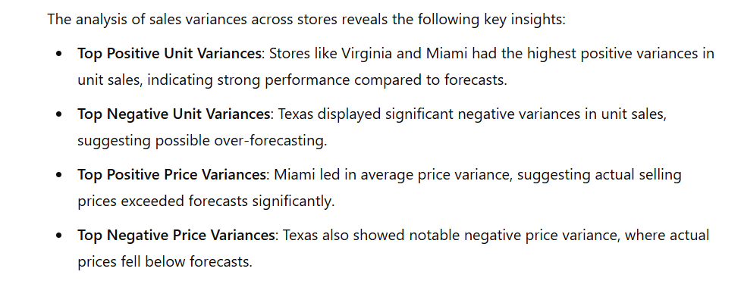
Outputs
© All rights reserved for Dr. Ryan Ahmed @Stemplicity Inc.

Slide 26
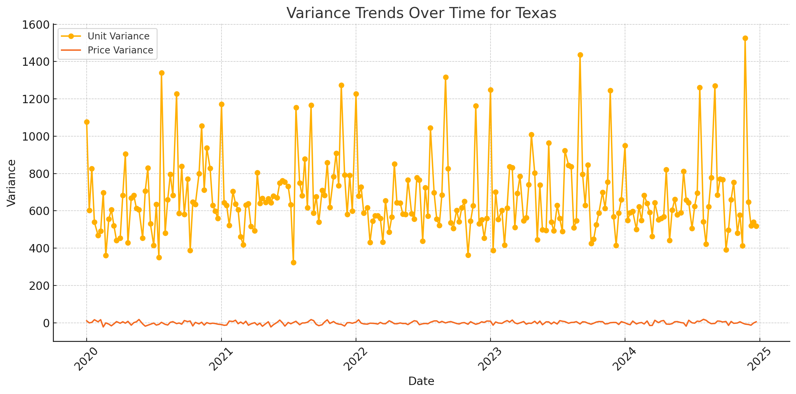
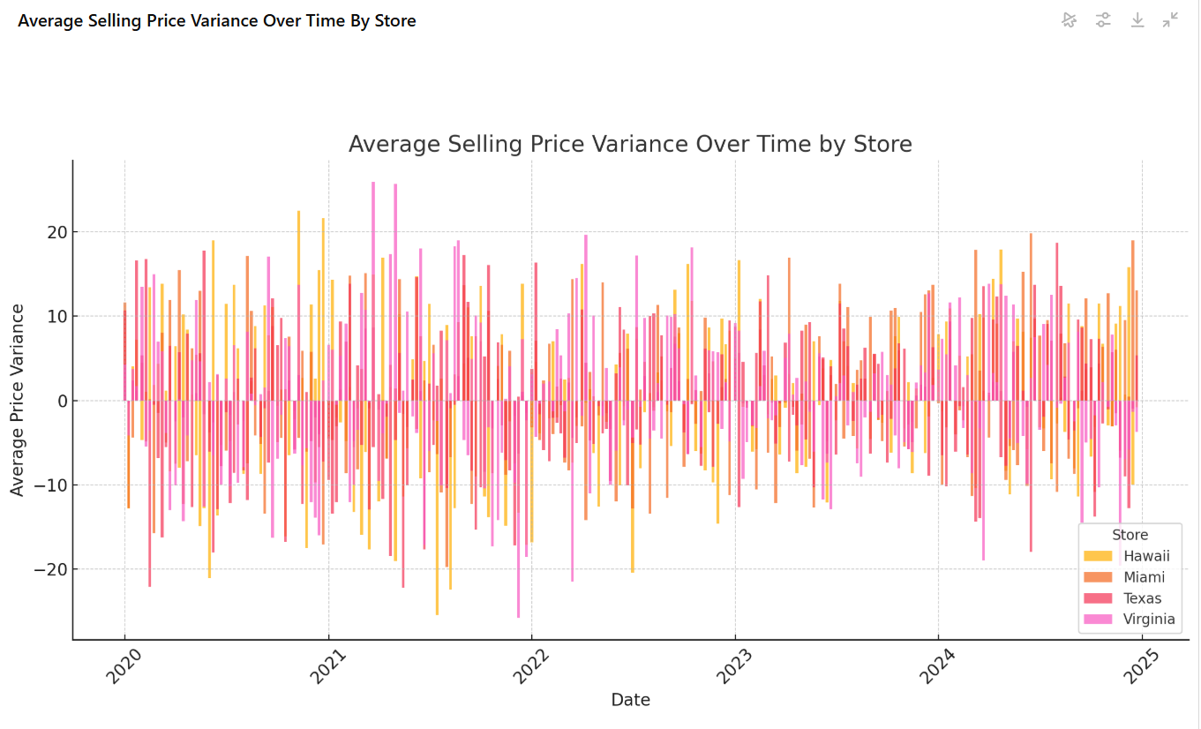
Outputs
© All rights reserved for Dr. Ryan Ahmed @Stemplicity Inc.

Slide 27
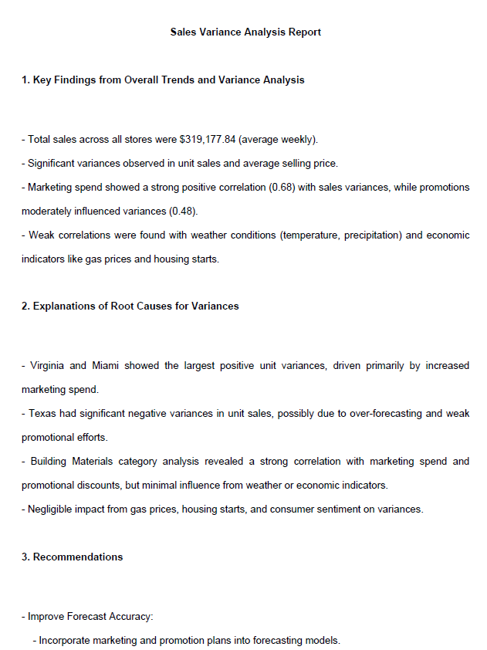
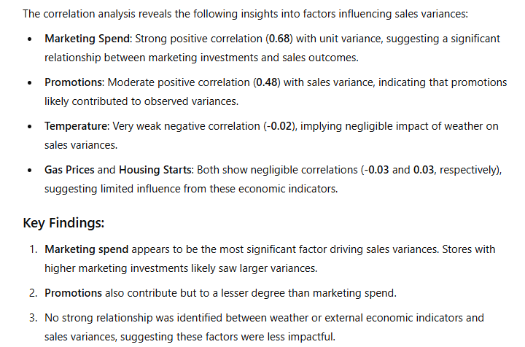
Output
© All rights reserved for Dr. Ryan Ahmed @Stemplicity Inc.

Slide 28
Thank you!

